Slide 1
PROPOSAL REPORT
Group No.3
BASC BATMAN'S ATTEMPT TO SAVE CATWOMAN
EN2532 – Robot Design and Competition
13.06.2020

Slide 2
Overall Strategy
We have divided the task into six subtasks.
Line following
Wall following & pillar detection
Circle navigation
Box manipulation and color detection
Ramp navigation
Gate area navigation
We thought of handling each subtasks in a modular manner
Switching between line following and wall following will be done by using the line follower and TOF sensors in each side
Box manipulation:
A gripping mechanism for the box
Two color sensors will be used
Ramp navigation will be done using a feedback loop of gyroscope and motors

Slide 3
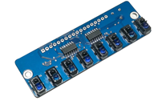
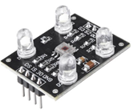
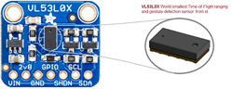
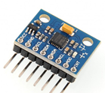
Sensors
The Raykha S8 IR sensor module
The TCS 3200 color sensor modules
2 sensors
one on the gripper to detect the front face
The other sensor to detect the bottom surface
VL530LX TOF sensor for distance measurement
2 sensors on either side for pillar and wall detection
1 sensor in front for the box detection
MPU 6050 Gyroscope

Slide 4
The Processing Unit
Arduino MEGA2560
Arduino modules have a wide range of libraries.
The clock speed, flash memory, RAM and Interrupt count is higher than UNO/NANO
Raykha S8
Arduino MEGA
I2C bus
Motor controller
Gyroscope
Arduino NANO
TOFs

Slide 5
The Processing Unit
Servo motor control for gripper arm
Color sensor control
Calculation based on detected colors
Arduino NANO
Arduino NANO
For better modularity and debugging, use a separate controller for the box handling mechanism.
A debugging interface, indicator LEDs are also connected to the main processor.

Slide 6
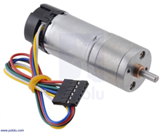
Actuators – Gear motors
According to our calculations for the worst-case scenario in previous assignment (4)
Total weight – 1.5 kg
Torque require for a wheel – 0.78 kgcm
Maximum stall torque - 1.036 kgcm
Maximum power output – 0.144W
Power require in climb down the ramp – 0.11W
Maximum speed need in flat ground – 26.52 rpm
For the above requirements we chose a motor which was Pololu 25D 12V high power 47:1 gear motor with encoders
Main specifications
No load speed & current – 210 rpm, 300 mA
Stall torque & current – 12 kgcm, 5.6A@12V

Slide 7
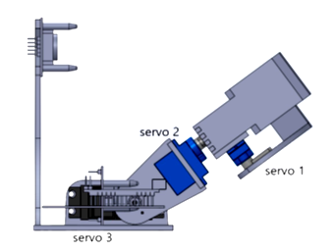
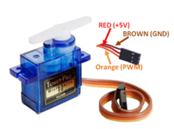
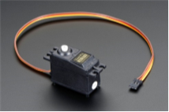
Actuators – Servo motors
According to our previous calculations on servo motors,
Servo1 maximum torque = 0.115 kgcm
Therefore we chose Tower pro SG90 servo for the servo1 & servo2.
Main specifications
Torque – 2.5 kgcm
Speed – dps
Servo3 maximum torque = 2.047 kgcm
Therefore we chose Tower pro SG5010 servo motor for servo3
Main specifications
Stall torque – 5.5 kgcm (4.8V)
Speed - dps

Slide 8
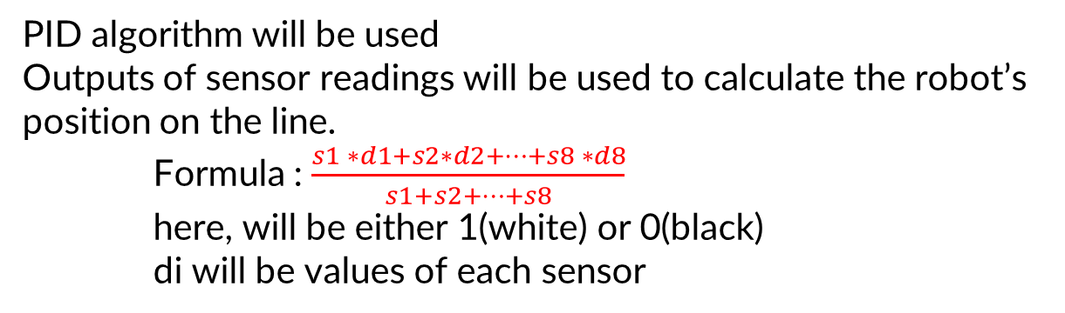
PID algorithm will be used
Outputs of sensor readings will be used to calculate the robot’s position on the line.
Formula : $\frac{s1 ∗d1+s2∗d2+…+s8 ∗d8}{s1+s2+…+s8}$
here, will be either 1(white) or 0(black)
di will be values of each sensor
Line Following
Readings from four VL530LX TOF sensors will be used
PID algorithm will be used
Image about taking reading
Wall Following

Slide 9
Detect the Circle
Navigate along the circumference until finding a radius and enter the radius.
Look for box with front TOF
If found in close proximity, come from other side and manipulate
If found in opposite radius, reach the box and manipulate
Else reach the center, check the side of the box, reach and manipulate
Take color sensor readings and calculate path
Drop the box and exit the circle in the shortest path
Circle Navigation
Detect end of a segment
Select the tangent direction and move given distance
Detect next segment
Adjust direction
Dotted Line Following

Slide 10
Detect the ramp, using front TOF sensor and Gyro.
Increase motor power for uphill motion
Adjust speed with response from gyro at the top of the ramp
Turn
Control speed while climbing down
Ramp Navigation
Side TOF sensors will be used to count the pillars
Adjust the course if needed
Proceed otherwise
Pillar Detection

Slide 11
Gate Passing
Use front TOFs to identify closed gates
Distance to cover = 120 cm
10s time to cross in the worst case, therefore required base speed 12cm/s
Maximum waiting time will be 17s
Three possible scenarios
Gate 1 is Closed: Wait until it is opened, pass through both gates.
Gate 2 is closed (G1 open) : Pass G1, then G2 will open.
Both gates are open: Wait until a gate is closed, choose scenario 1.

Slide 12
Power Plan
The robot will be powered by two Li-Po batteries - dual battery setup
7.4V 2200mAh 25C battery
11.1V 2200mAh 25C battery
Three voltage regulators – all LM2596S
9V supply for drive motors, Arduino MEGA and OLED display
Two 5V supplies for sensors, servo motors and other components
Battery level indicators will be used with both batteries to avoid over-drain of batteries
Two PCBs would be used to minimize the wiring
PCBs will be finalized after breadboard testing
DIP switches will be used to control each component during testing
Alternatives for 9V regulator: XH-M401 module or two XL6009 modules in parallel

Slide 13
Task Delegation
Phase 1: Preliminary design
Pamuditha: peripheral components, robot body, coordination
Tharindu: box collection, color sensing
Yasod: circle navigation, ramp navigation
Vidura: gate area, (arena)
Thieshanthan: wall following, pillar detection
Yomali: line following, (arena)

Slide 14
Task Delegation
Phase 2a: Virtual implementations
Schematic and PCB: Thieshanthan, Vidura
Coding: Pamuditha, Tharindu, Yomali
Mechanical design: Yasod
Phase 2b: Actual implementation
Phase 3: Testing
We are currently in the phase 2a.
Task delegation for phase 2b and phase 3 will be decided when the university starts.

Slide 15

Ramp Simulation

Slide 16
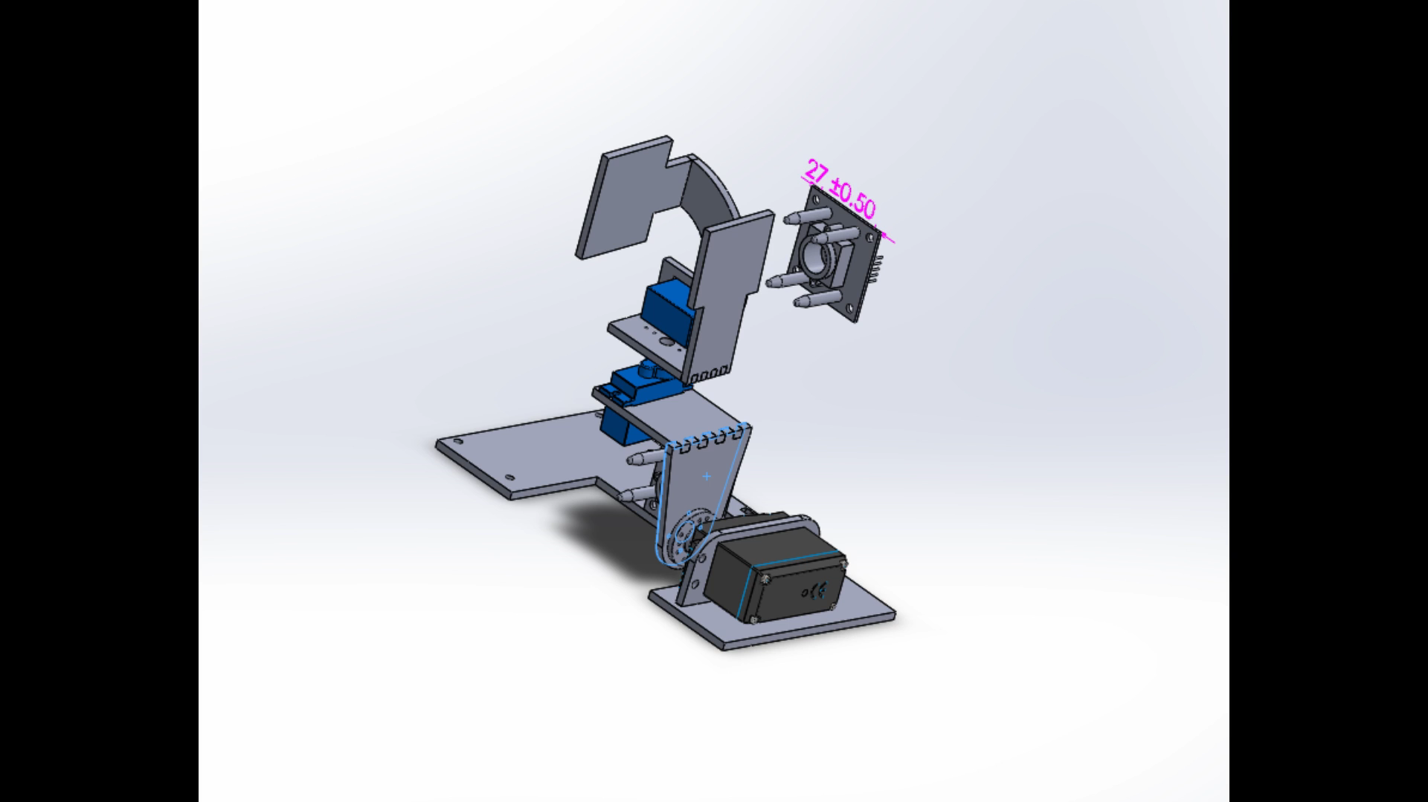
Arm Simulation

